Slide 1
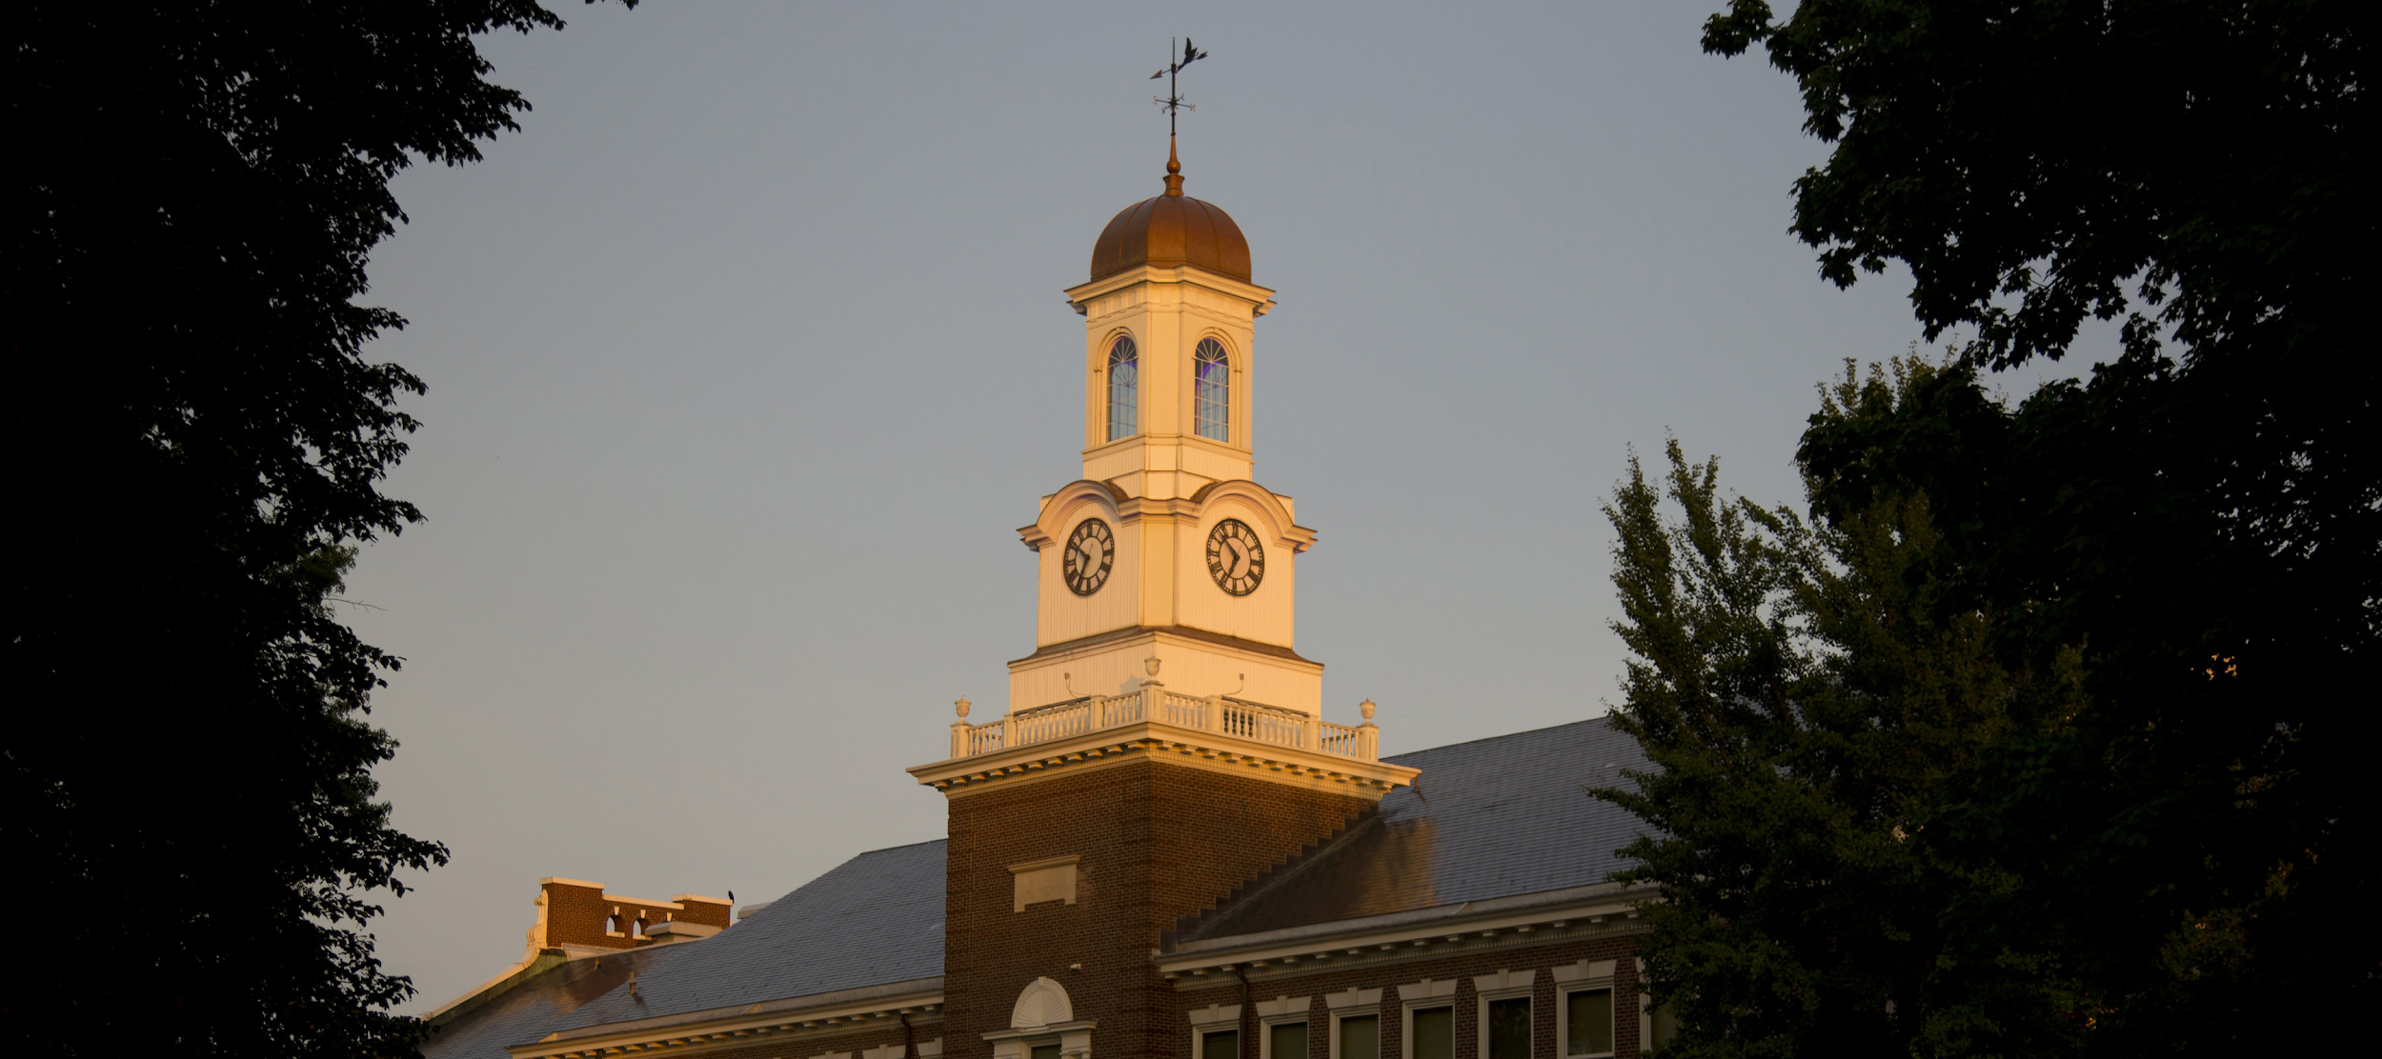
Superintendent’s Report
08-27-19
Notes:
Summer has been a very busy time at RFH. In an effort to communicate, we will provide a brief Superintendent’s Report at each meeting about important things going on in our school.

Slide 2
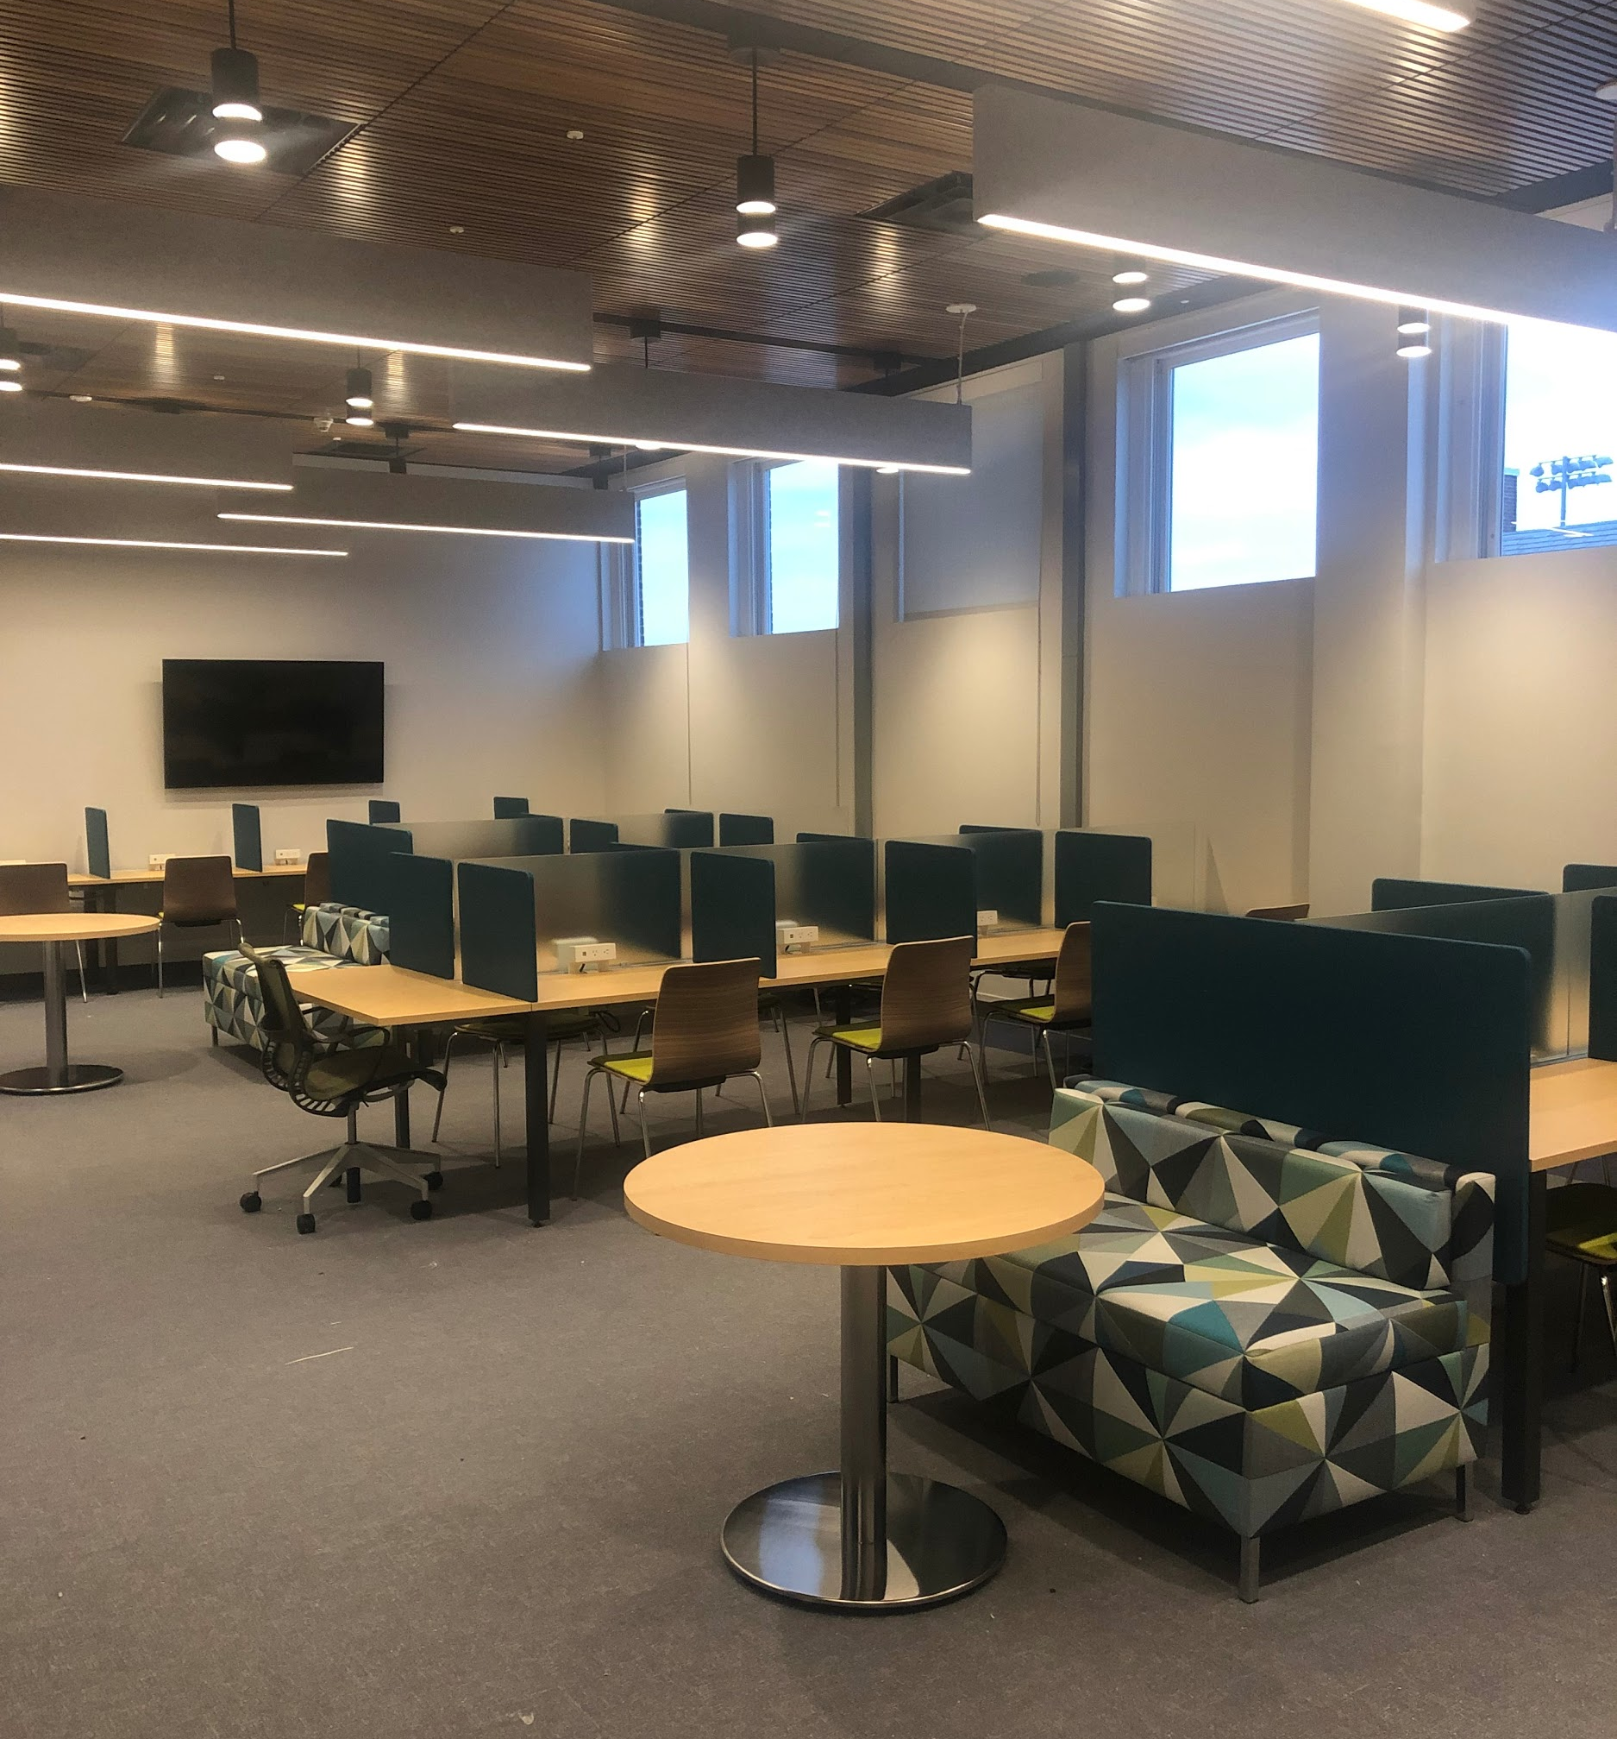
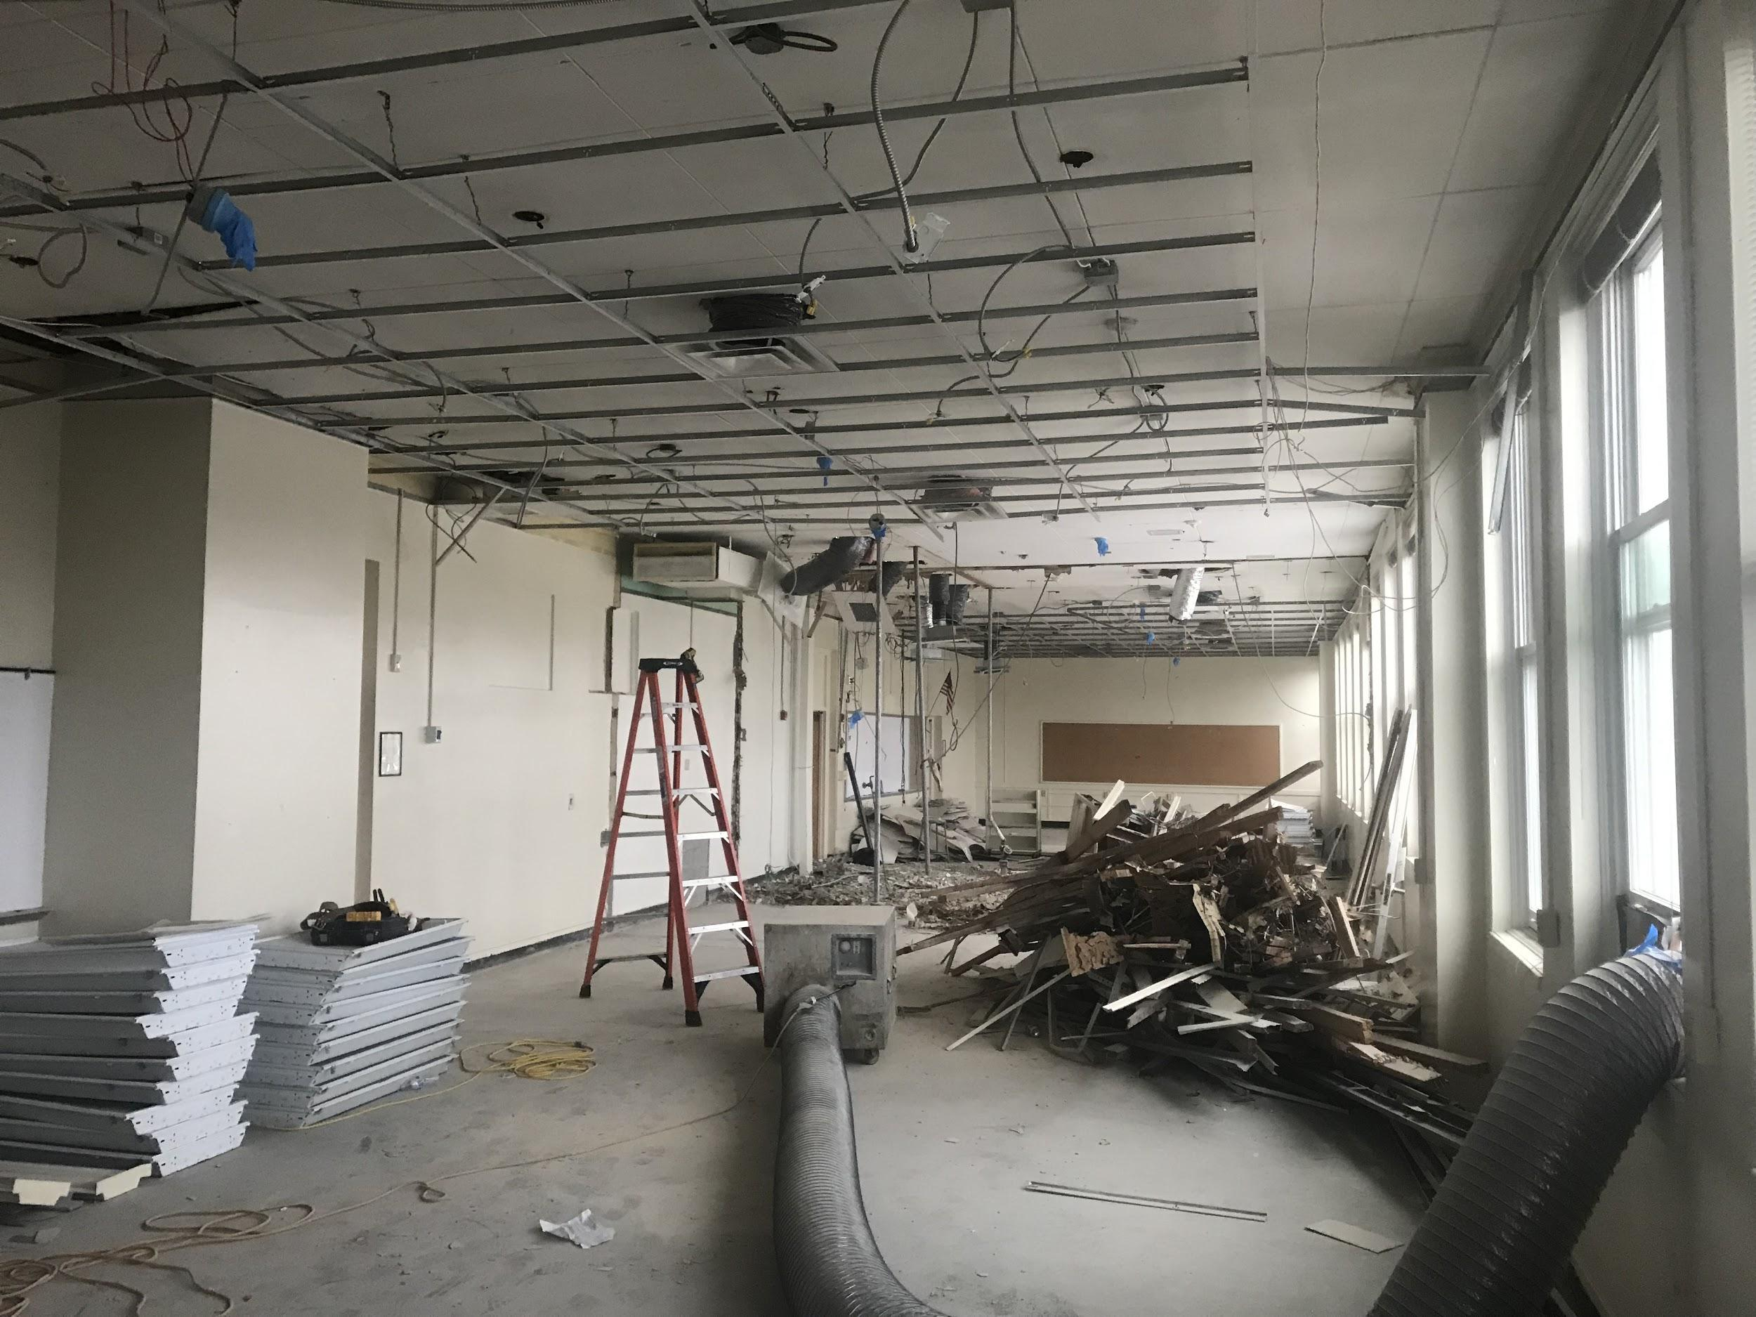
Construction Updates
The Summer of 2019 marks the first phase of our Referendum work. This phase focused on classroom renovations in the 300 and 400 wings. The space on the third floor has been completely transformed. We look forward to our students using our stunning and acoustically advanced Dr. Peter Righi World Language Lab.

Slide 3
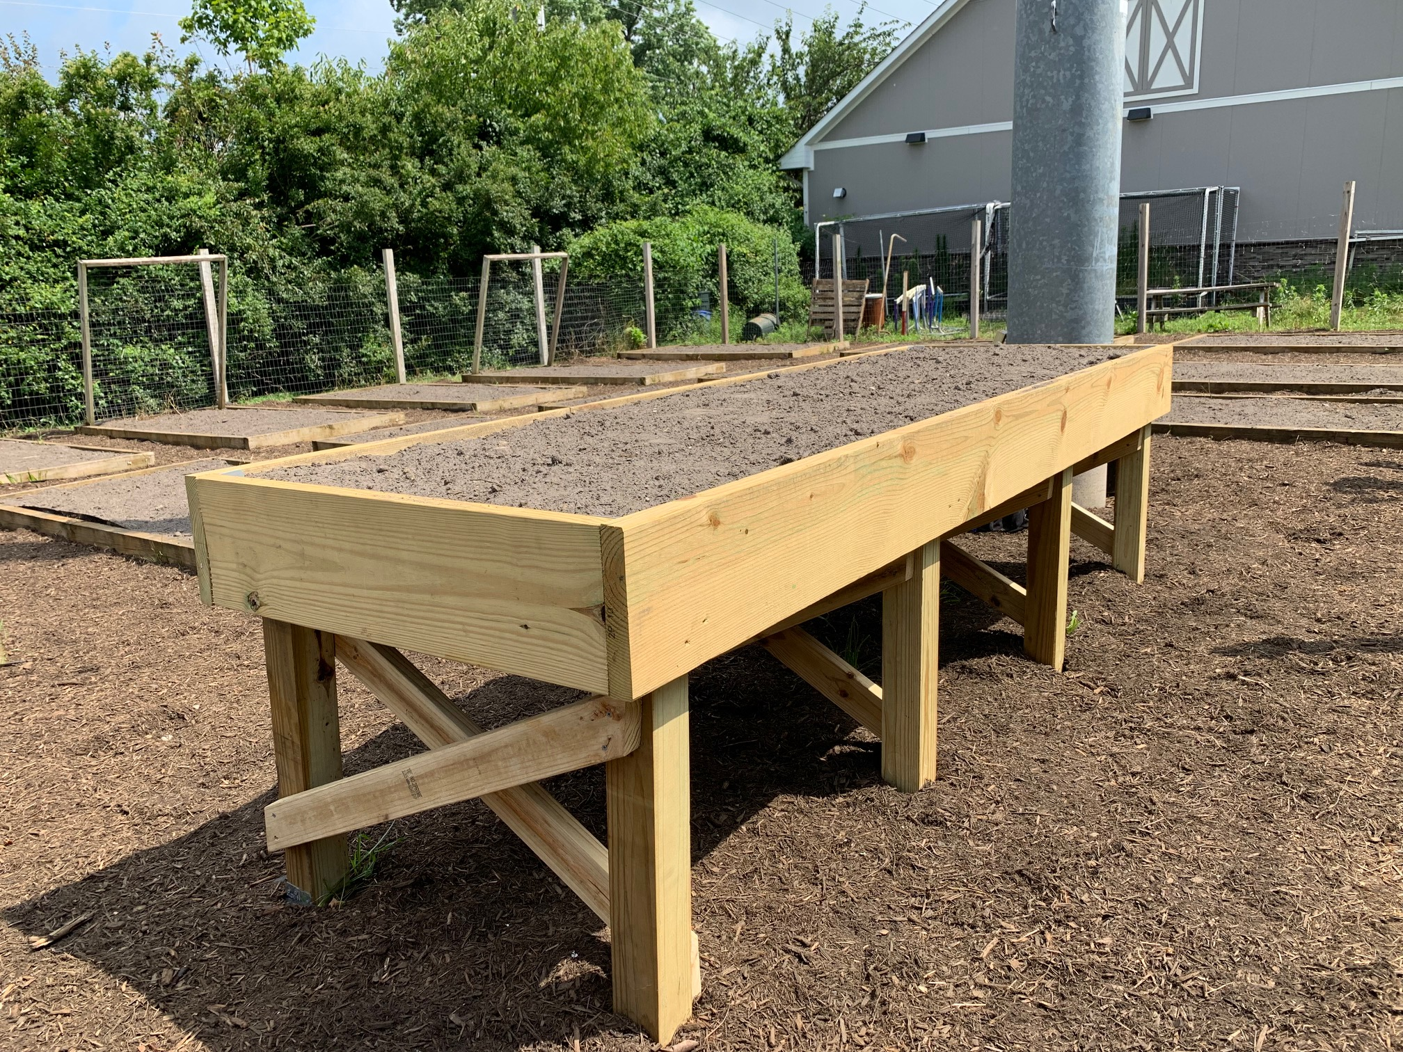
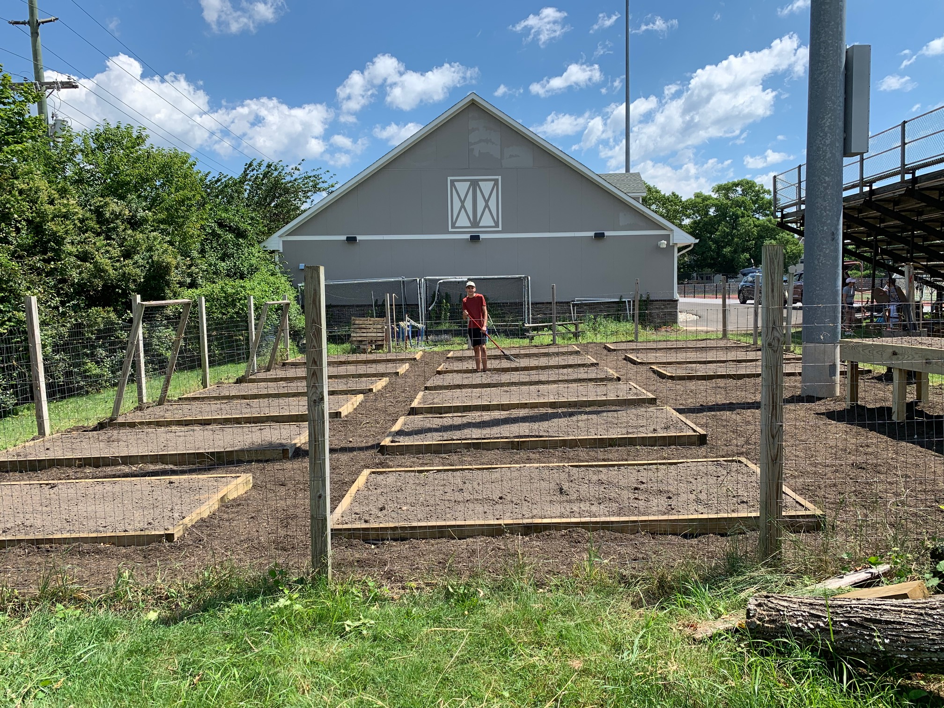
ESY - Special Thanks
During the summer, some of our students participated in the Extended School Year program. With the help of Boy Scout Troop 201 and the generous donation of Ryser’s Landscape Supply, who donated most of the material, RFH student Carter Sutsko completed his Eagle Scout project at RFH. They provided us with a renovated garden complete with an elevated planting bed which is ADA compliant. Our students, with the help of our dedicated ESY staff, harvested a bumper crop of basil as part of their work this summer.
Notes:
During the summer, some of our students participated in the Extended School Year program. With the help of Boy Scout Troop 201 and the generous donation of Ryser’s Landscape Supply, who donated most of the material, RFH student Carter Sutsko completed his Eagle Scout project at RFH. They provided us with a renovated garden complete with an elevated planting bed which is ADA compliant. Our students, with the help of our dedicated ESY staff, harvested a bumper crop of basil as part of their work this summer.

Slide 4
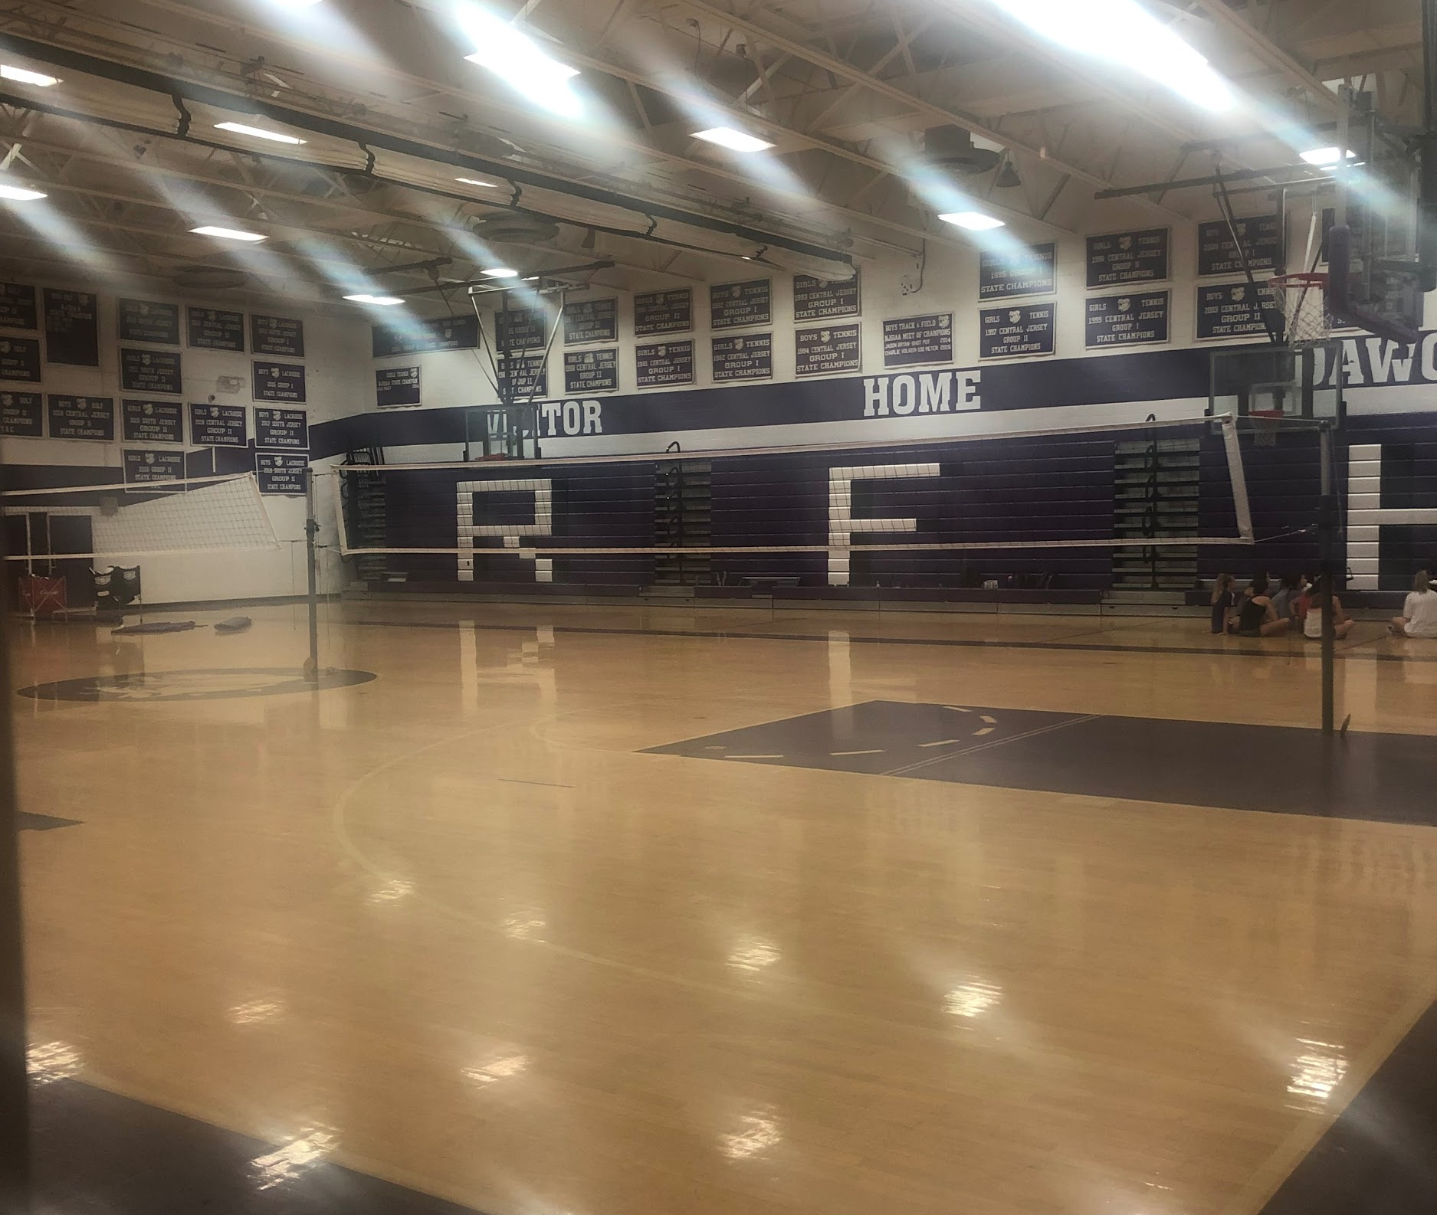
Athletics and Activities
If you have driven by the RFH campus during the past week, you would think school is in session, as our gyms and fields have been buzzing with athletes. We already have had winning scrimmages. We have approximately 600 of our students on campus participating in fall sports, marching band or our fall play.

Slide 5
School starts Thursday, September 5, 2019
Save the Date!!
Back to School Night is Tuesday, September 10, 2019
School starts for students on Thursday, September 5, 2019 with a regular full day schedule. Dr. Handerhan, RFH principal, was interviewed for the The Two River Times Back to School issue, published in the August 15 - 21 edition. Among other suggestions, Dr. Handerhan reminds students and parents to be careful not to overschedule themselves, and get enough sleep so that they can perform at their best in the classroom. Parents and students should check their emails and log into the PowerSchool portal for important information about schedules and student arrival. I join Dr. Handeran and the entire RFH faculty and staff in welcoming everyone back to school. We look forward to seeing you at Back to School Night on September 10, 2019.

